Slide 1
BDA
Logistic Regression

Slide 2
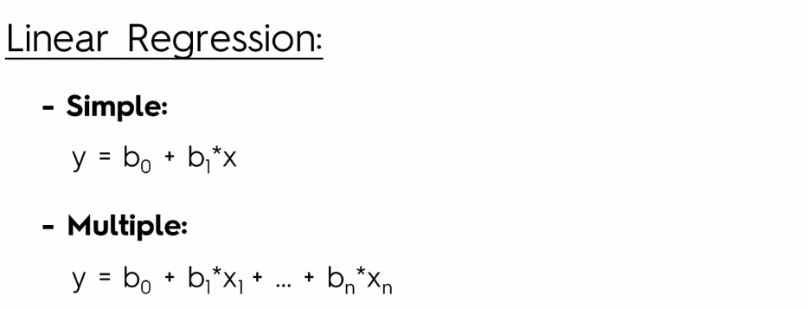
Logistic Regression

Slide 3
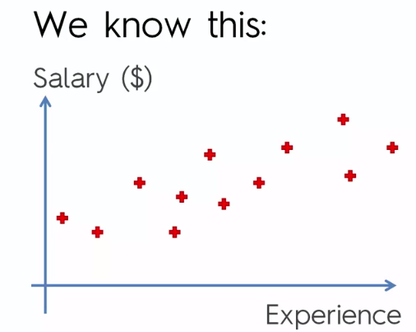
Logistic Regression

Slide 4
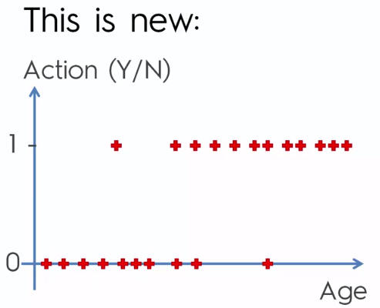
Logistic Regression

Slide 5
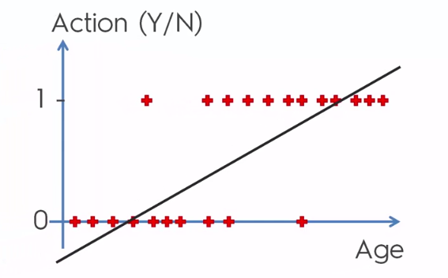
Logistic Regression

Slide 6
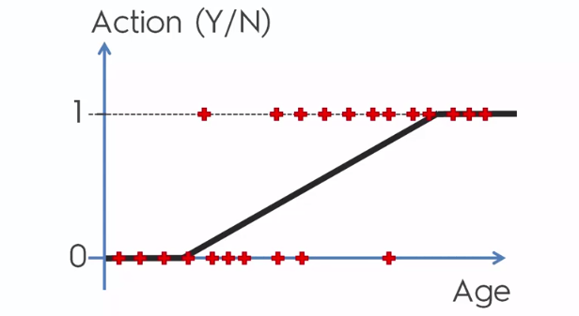
Logistic Regression

Slide 7
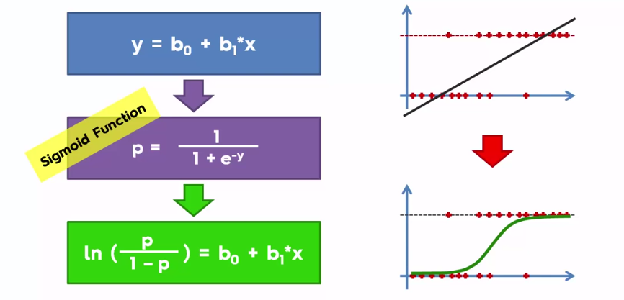
Logistic Regression

Slide 8
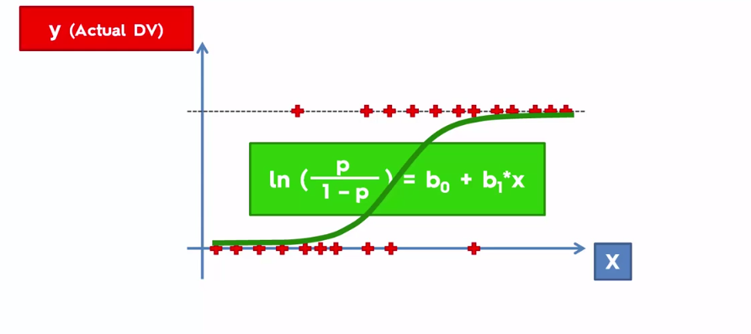
Logistic Regression

Slide 9
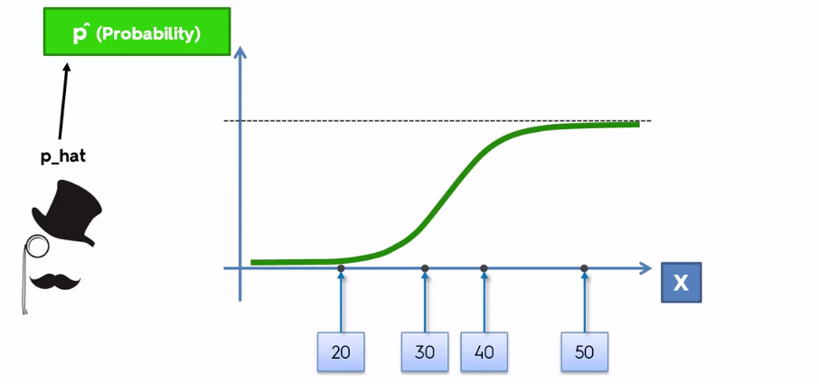
Logistic Regression

Slide 10
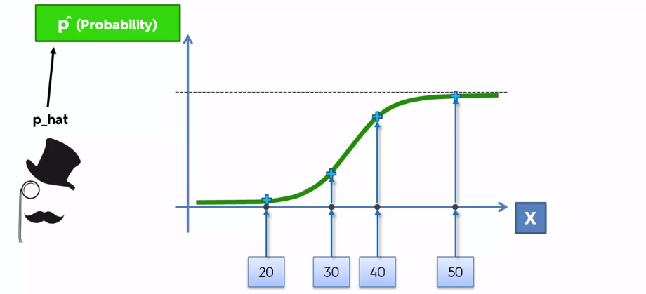
Logistic Regression

Slide 11
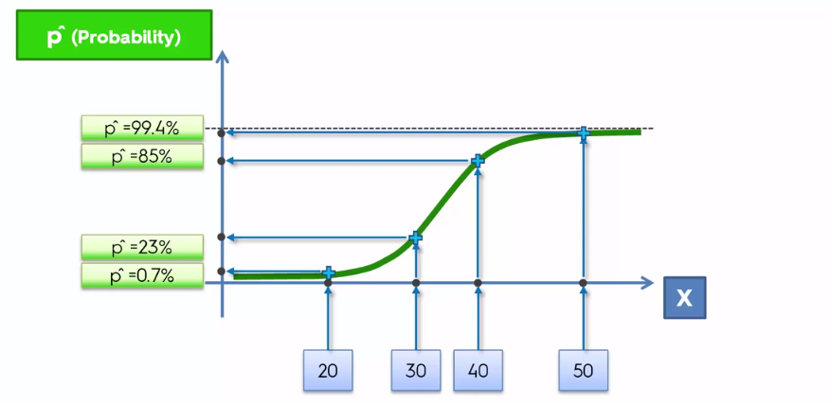
Logistic Regression

Slide 12
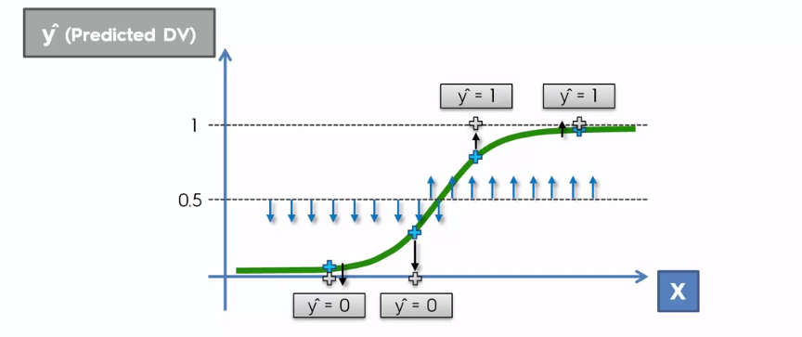
Logistic Regression

Slide 13
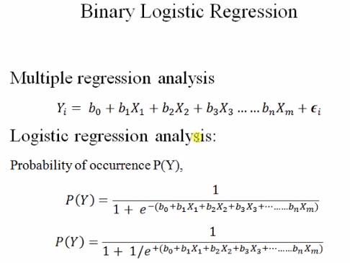
Logistic Regression

Slide 14
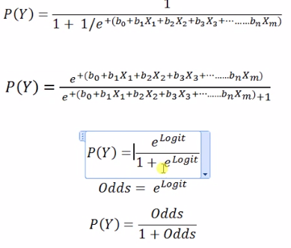
Logistic Regression

Slide 15
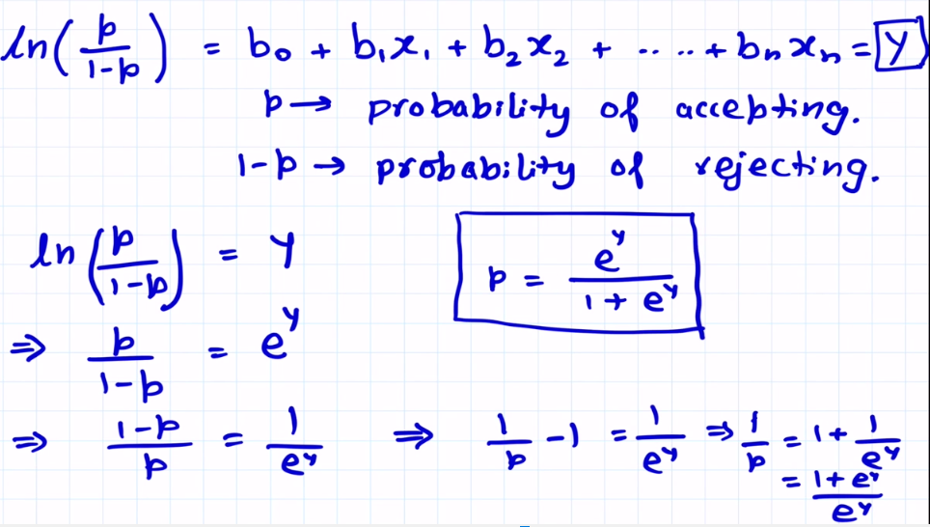
Logistic Regression

